Slide 1
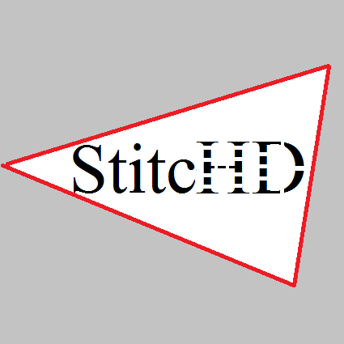
NASA StitcHD
Heather Young
Luke Yeager
Sam Hatfield
Notes:
Heather

Slide 2
Introduction
Need: Replace spacecraft windows with alternate system
Proposed solution: "virtual window" with externally mounted cameras
StitcHD assignment: Create a single, panoramic video display from multiple camera feeds
Notes:
Heather

Slide 3
Introduction
Objectives:
Handle four input camera streams simultaneously
Output panoramic stream in real-time
Support high-definition camera resolutions and speeds
Make edges between streams as seamless as possible
Allow scene and camera movement
Notes:
Heather

Slide 4
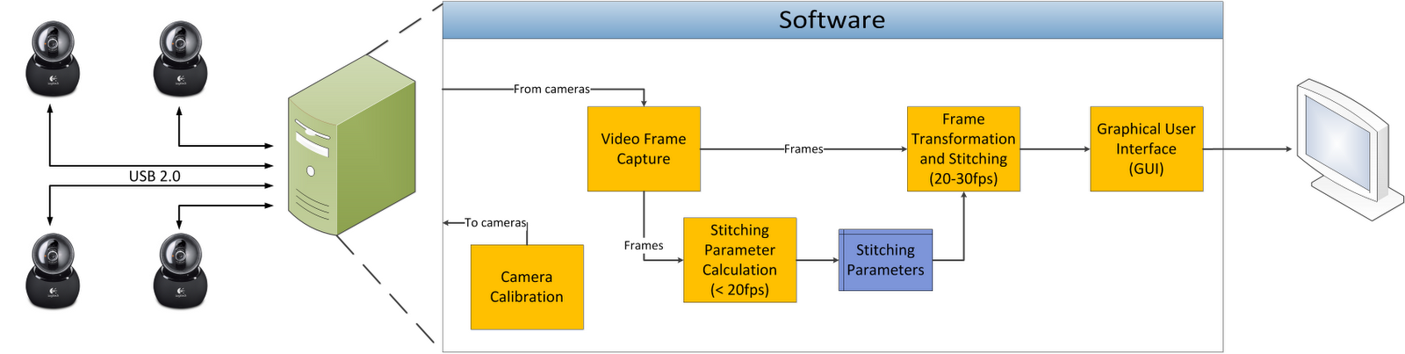
Design Overview
Notes:
Sam

Slide 5
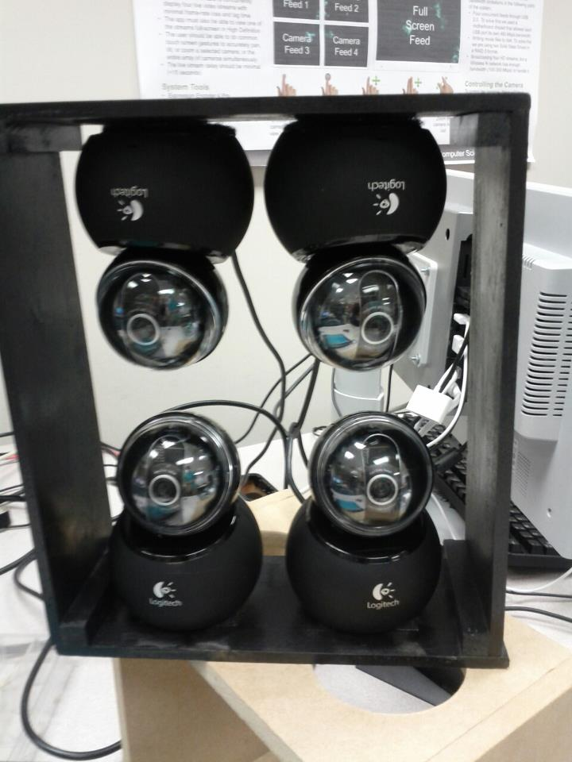
Video Capture
Input: Four Logitech Orbit AF HD Webcams
Capture thread for each input
Specialized hardware to combat bandwidth bottleneck
Allow interactive pan/tilt adjustment in GUI
Future work: color correction between cameras?
Notes:
Sam

Slide 6
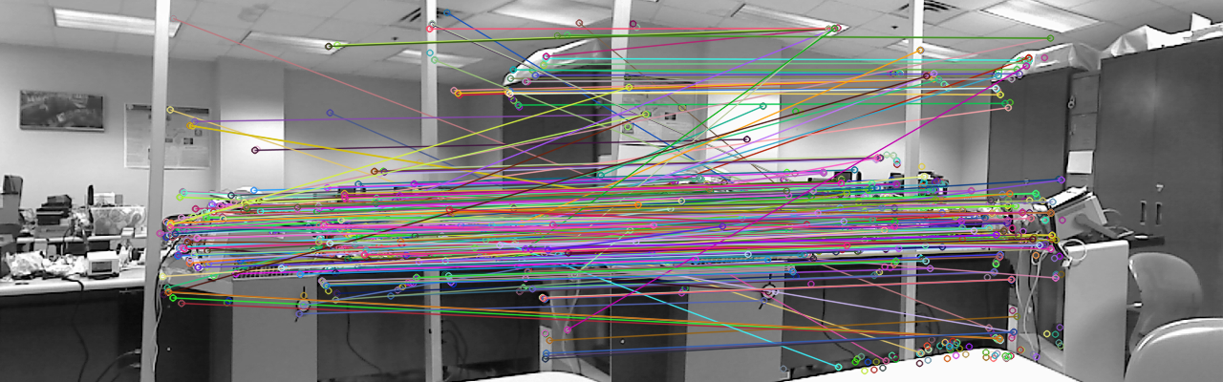
Perspective Calculation
Calculate keypoints
Match keypoints
Calculate homography matrix
Notes:
Sam

Slide 7
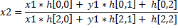
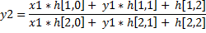
Homographies
Matrix used to specify transformation of one frame onto the plane of another

Slide 8
Homog. Parameters
Important parameters in the homography module:
Frame Overlap: sets the region of interest in each frame
Hessian Threshold: determines what is considered a “keypoint”
FLANN Search Type: choose between brute-force, kd-tree, or auto-optimized keypoint matching
RANSAC Threshold: sets the limit of error to consider in keypoint matches
Time Average Ratio: sets the weight of a newly calculated homography in relation to the previous homography

Slide 9
Stitching Algorithms
Stitching implemented on the GPU using a custom CUDA kernel
Works for arbitrarily many cameras
Using bilinear interpolation
Using various types of alpha blending
Notes:
Luke

Slide 10
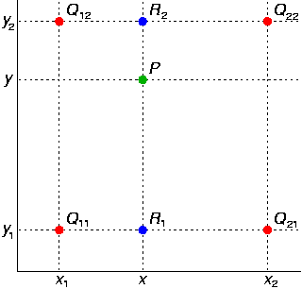
Bilinear Interpolation

Slide 11
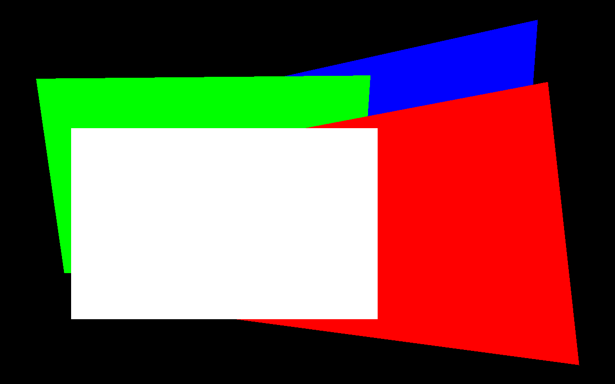
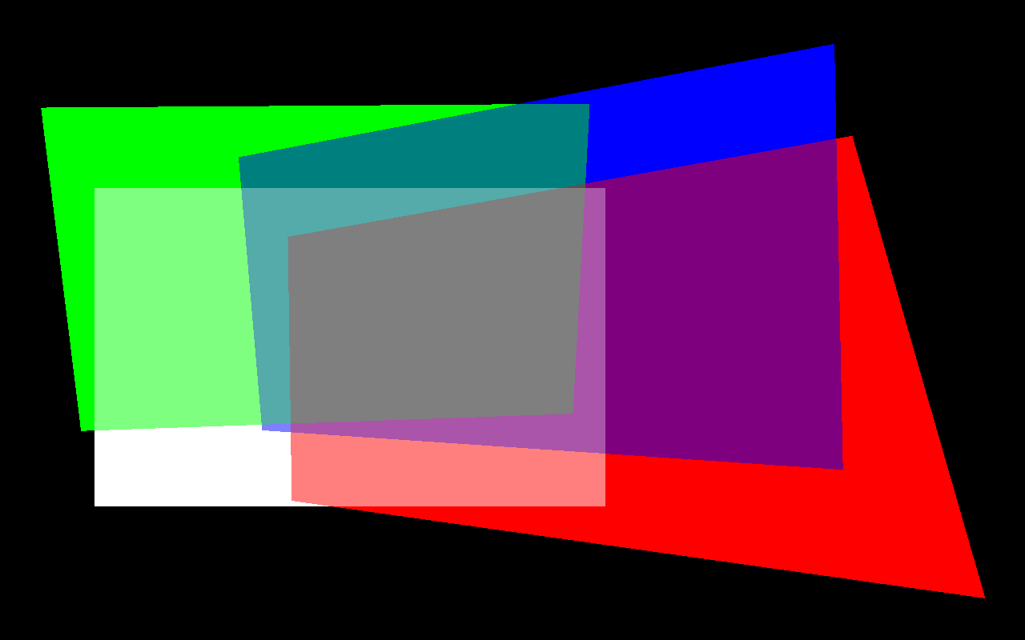
Image Alpha Blending

Slide 12
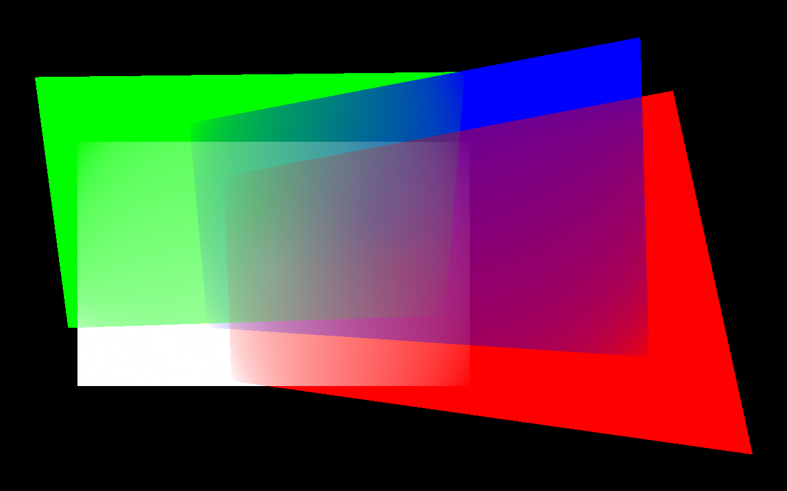
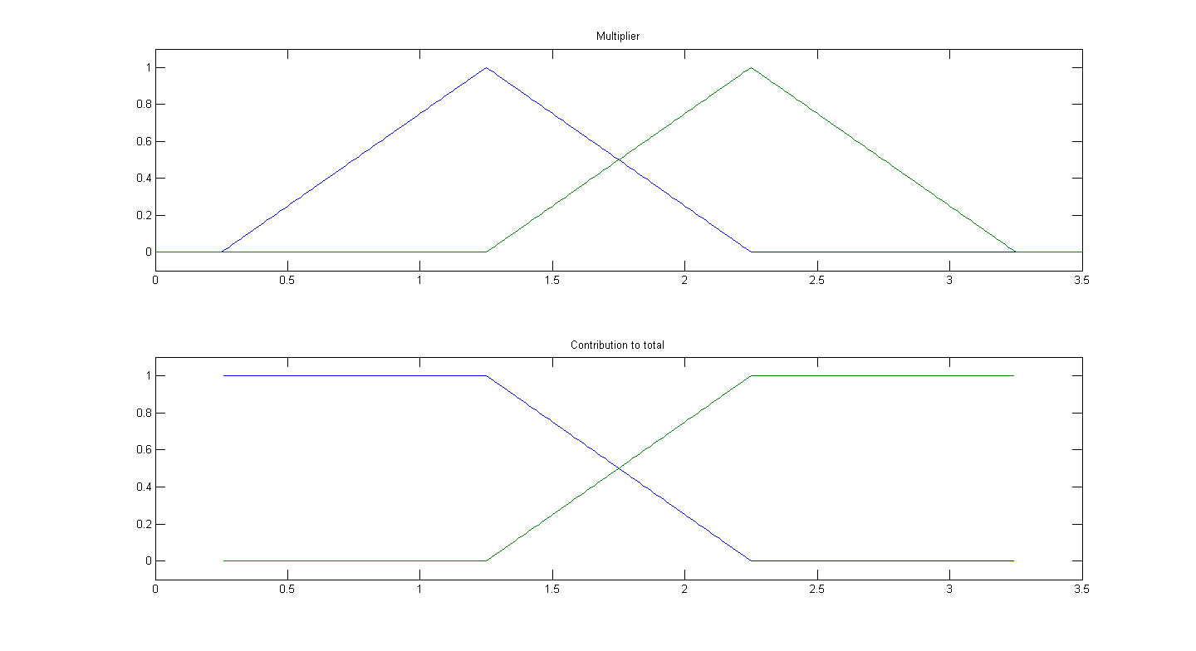

Slide 13
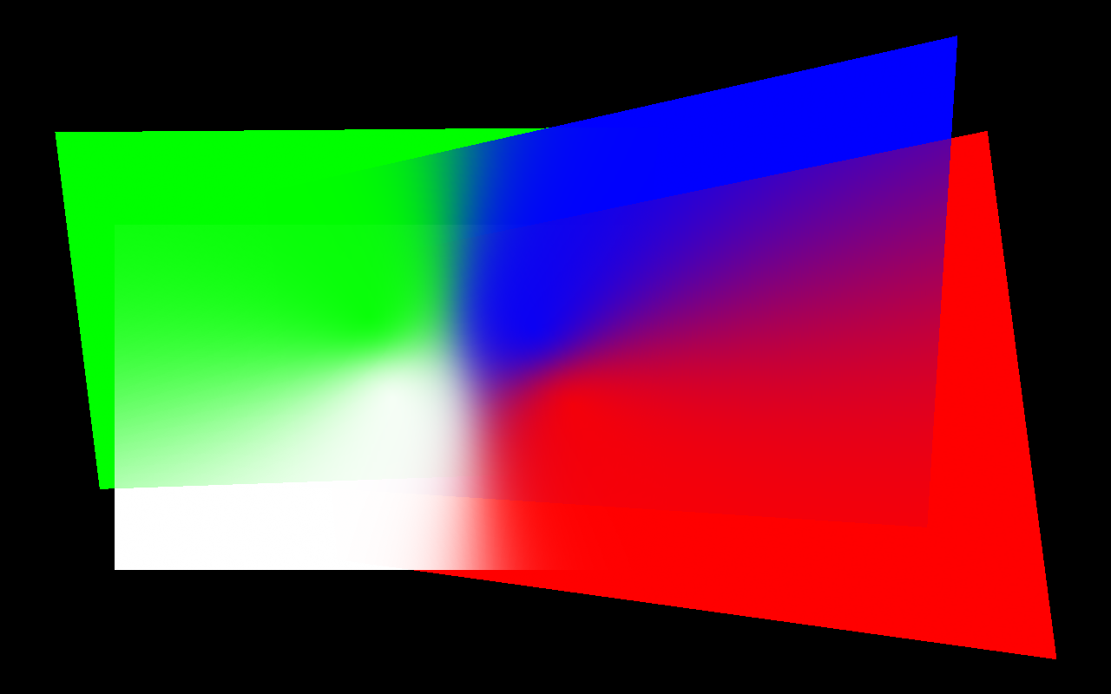
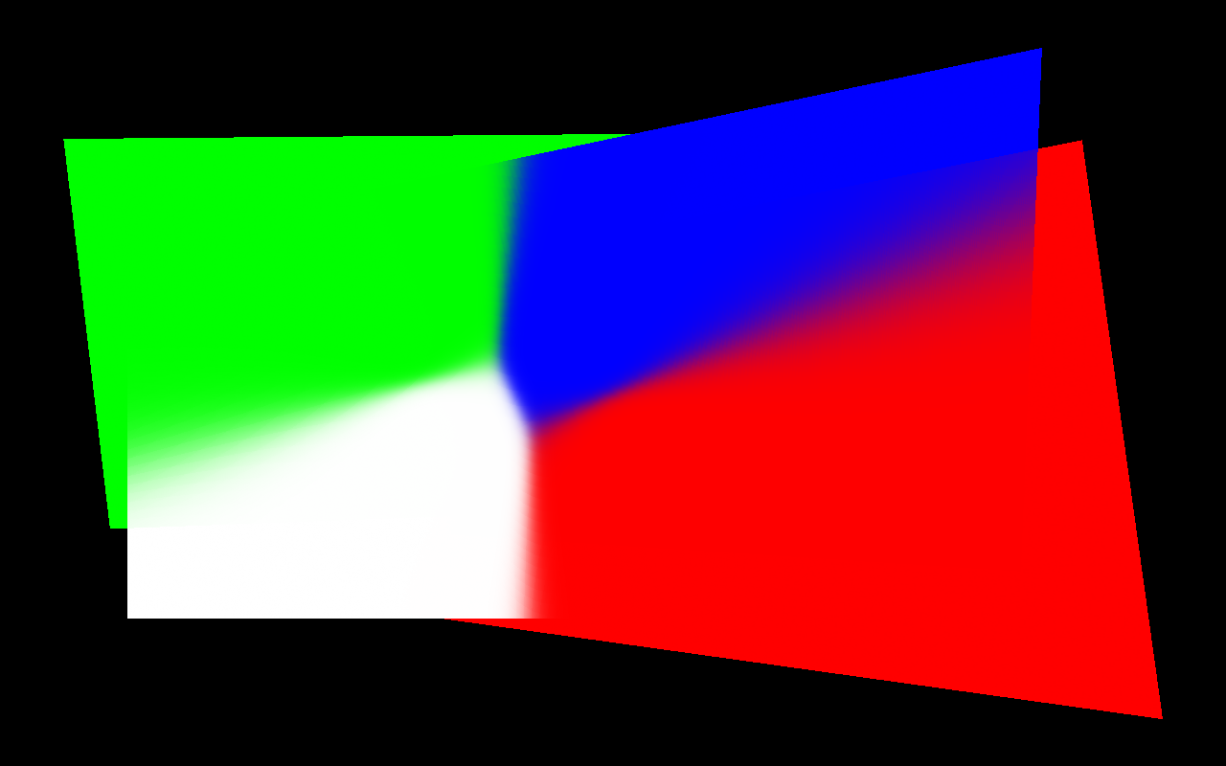
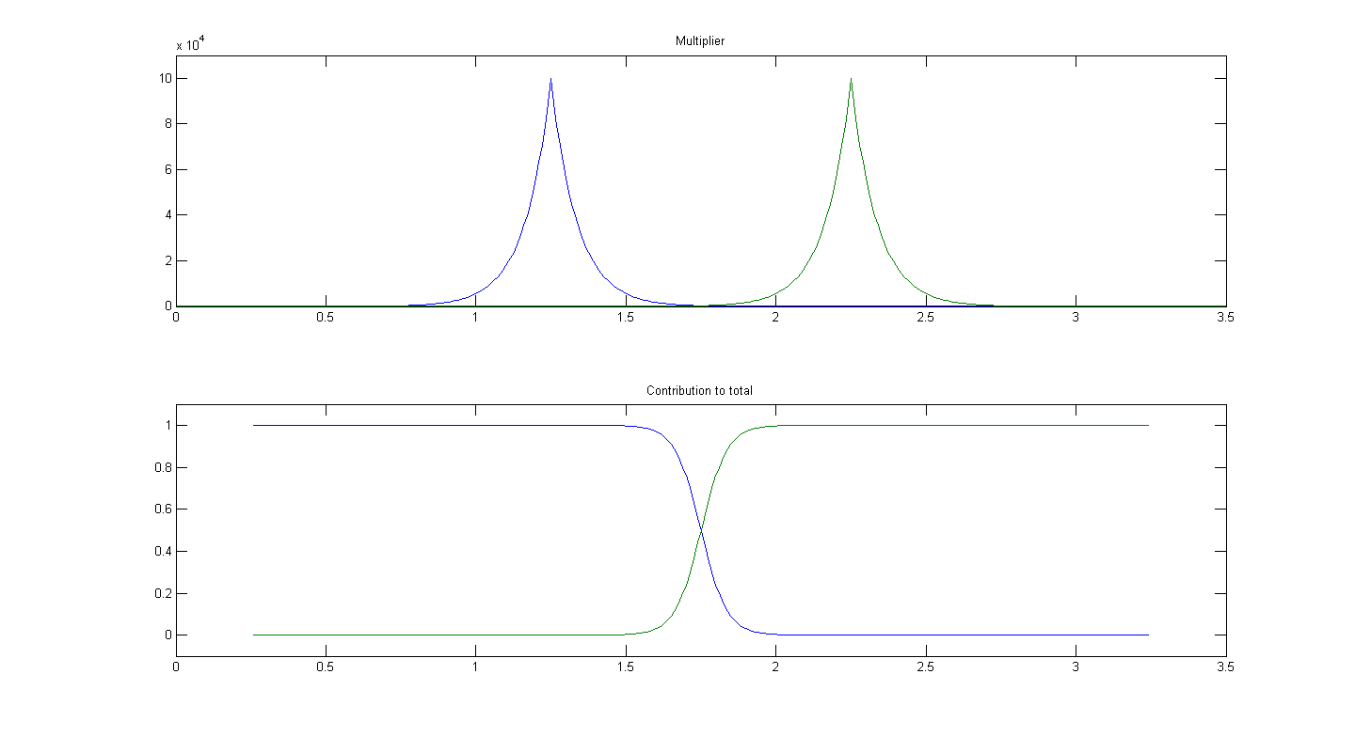
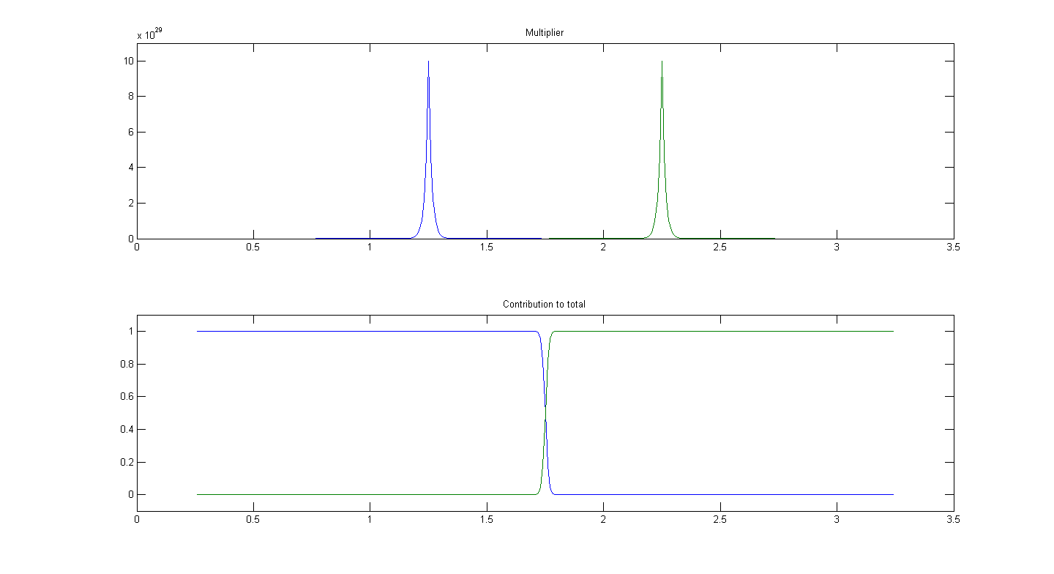

Slide 14
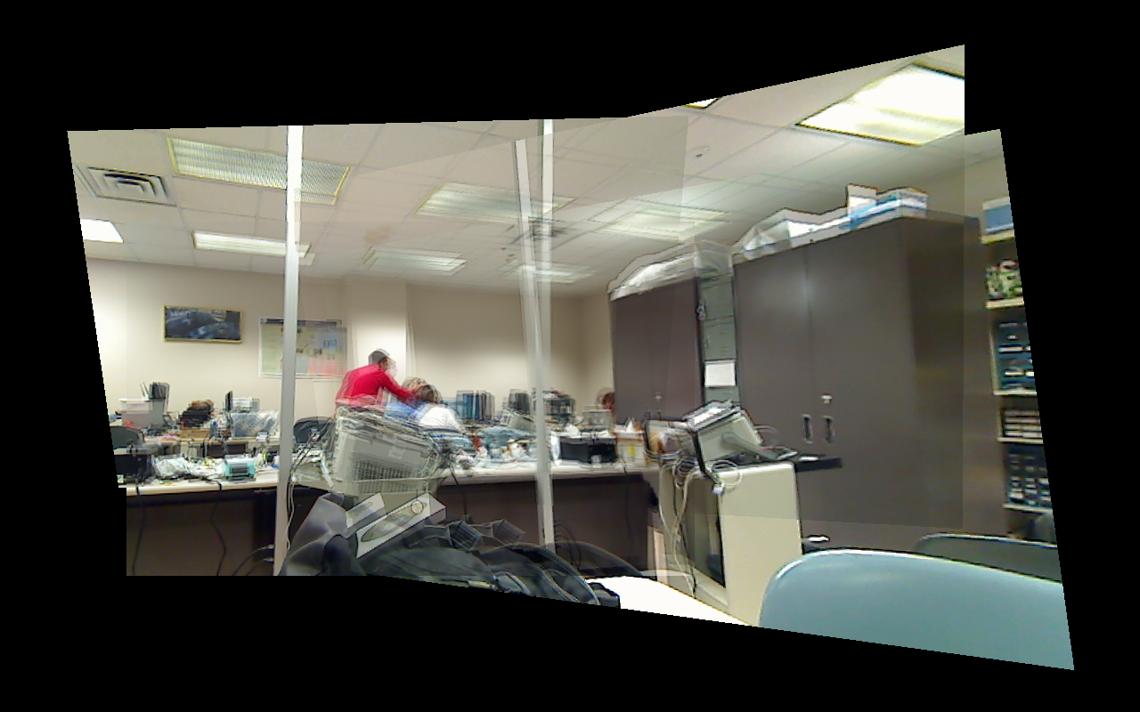
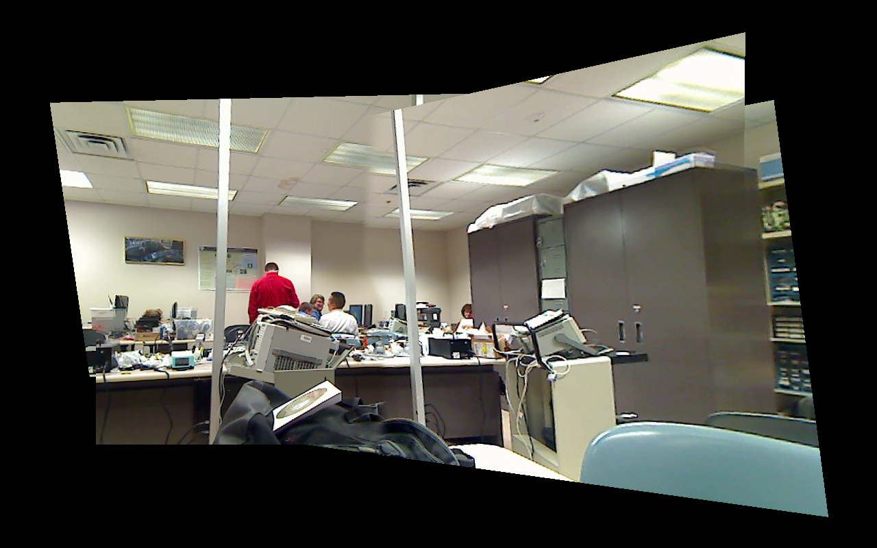

Slide 15
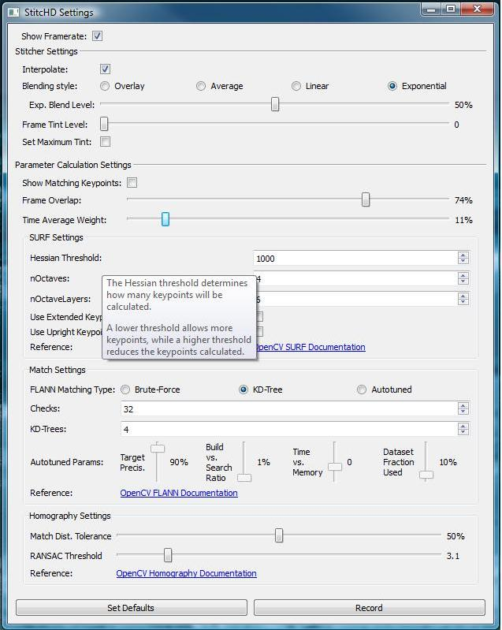
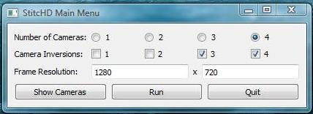
GUI
Notes:
Luke

Slide 16
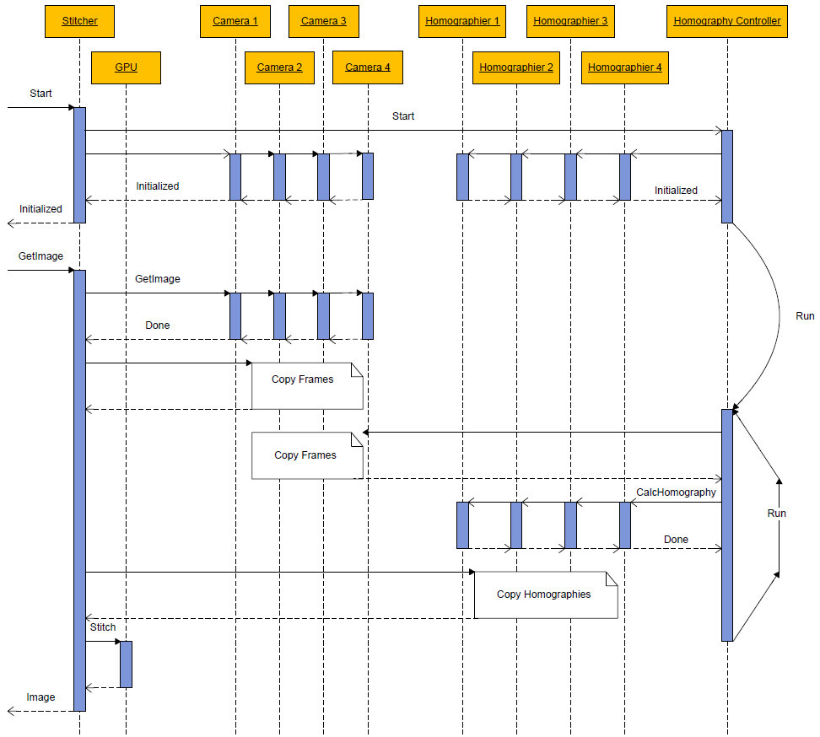

Slide 17
Design Alternatives
Camera Interface: DirectShow vs. OpenCV
GPU Usage: Stitching vs. Homography
Parameters: Provide many control options
GUI: wxWidgets vs. OpenCV Qt vs. Full Qt
Notes:
Luke

Slide 18
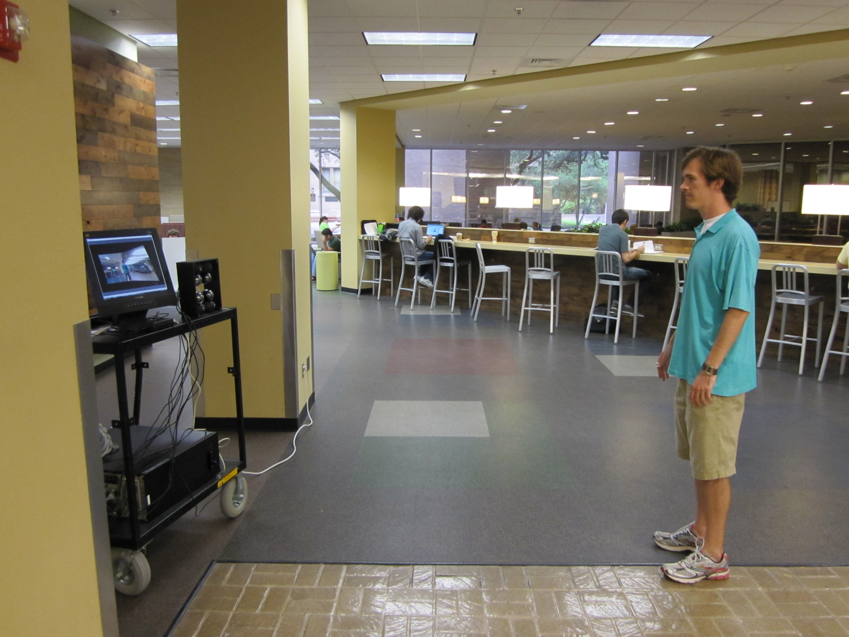
Testing
Notes:
Luke/Sam

Slide 19
Demo Video
One moment please…
Notes:
Luke/Sam

Slide 20
Questions?

Slide 21
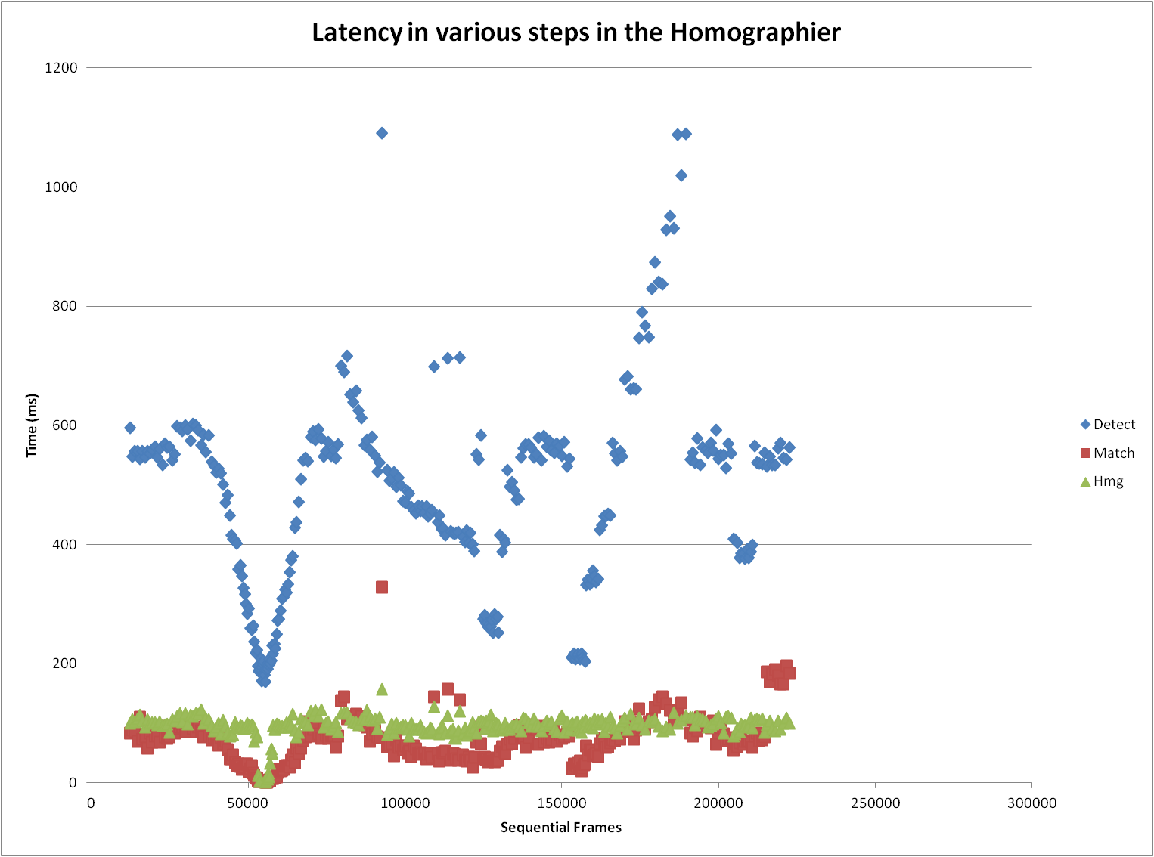
Results
Notes:
Luke/Sam

